Slide 1
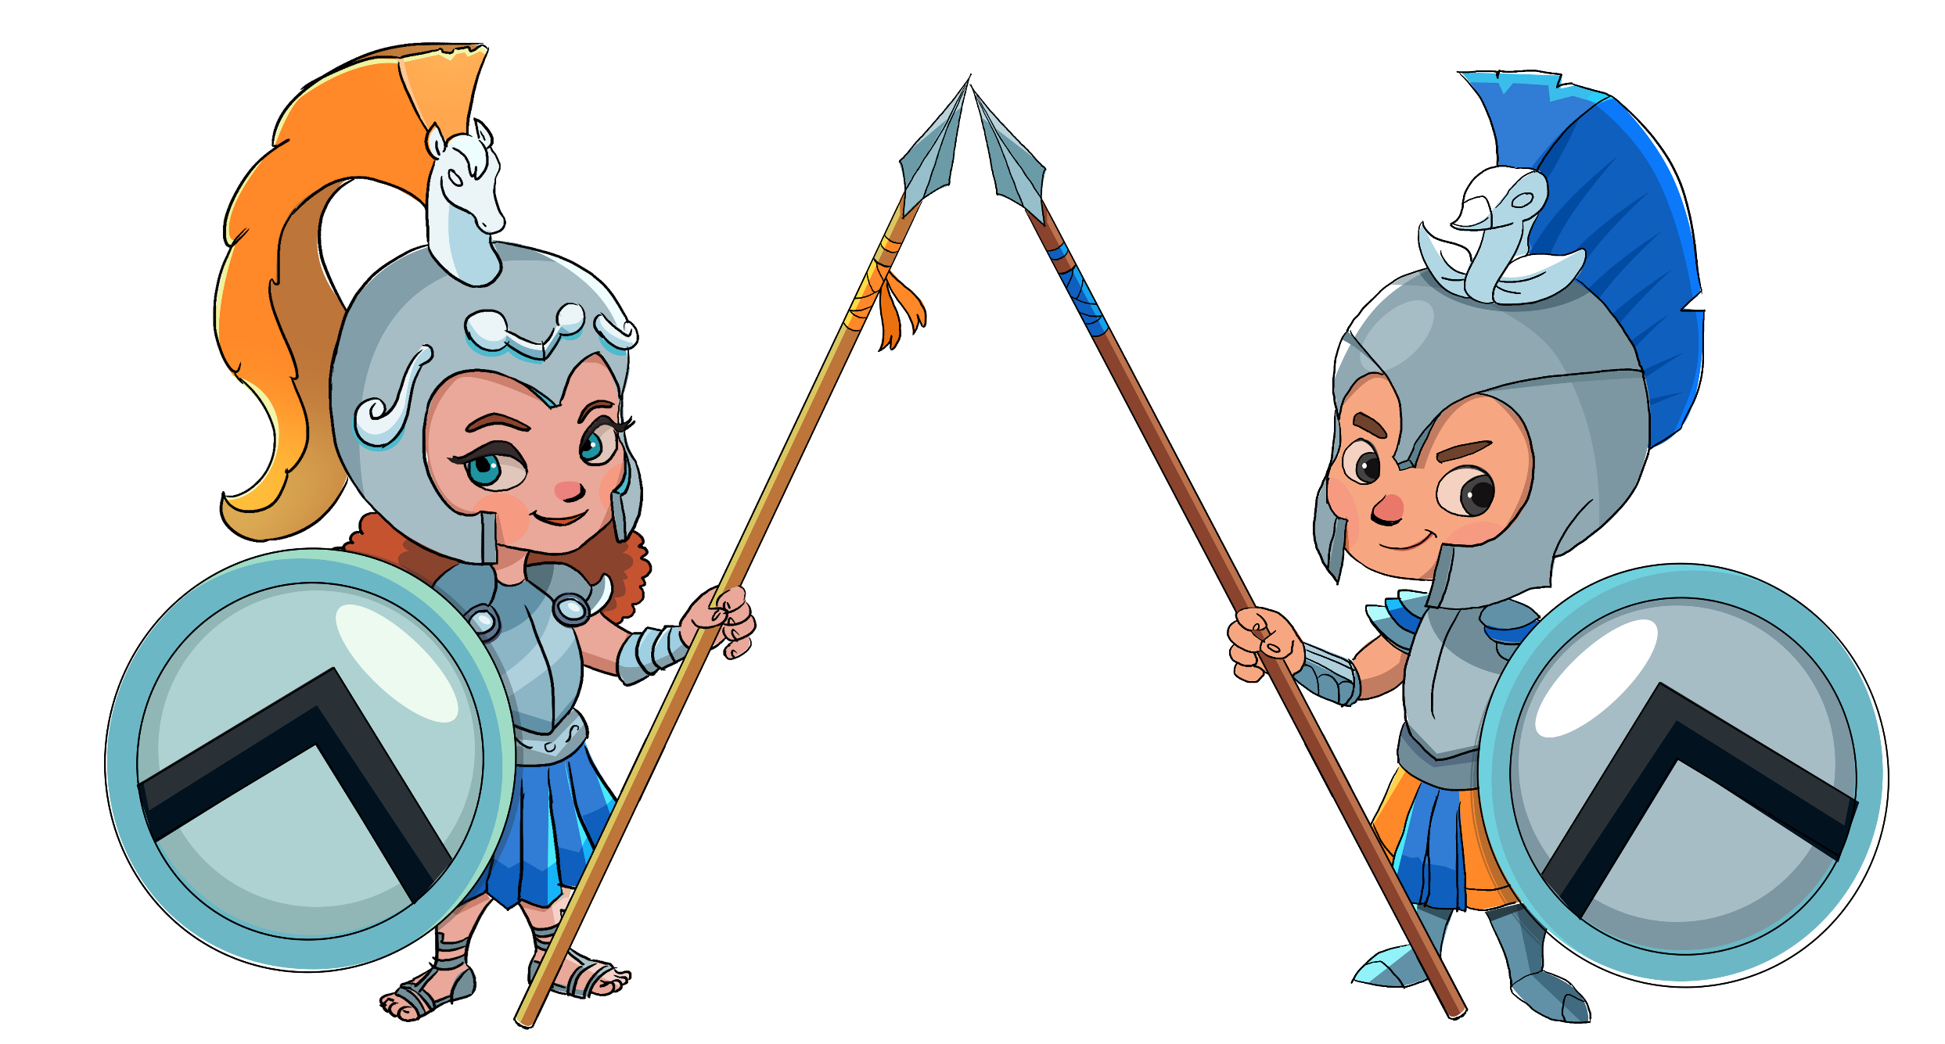
Learn to Play Cyber Threat Protector

Slide 2
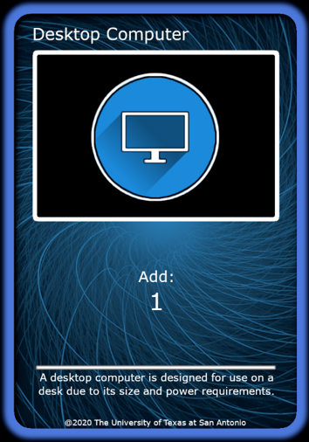
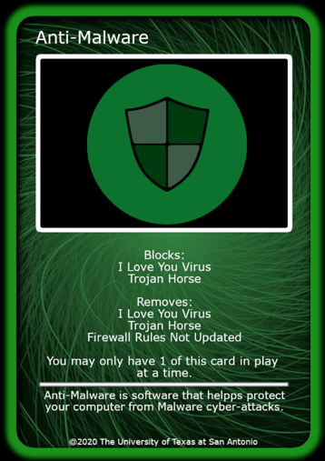
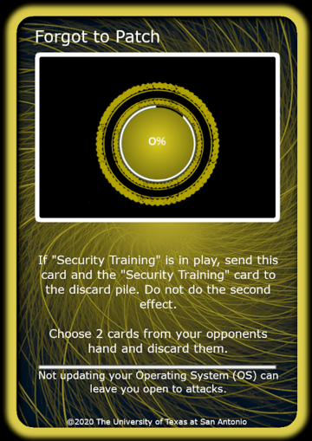
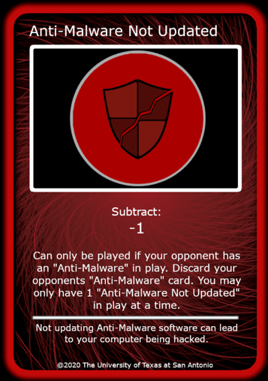
Core Concept of Cyber Threat Protector
Create a network of Assets to gain points
Build Defenses to prevent malicious Attacks and Events against your Assets
Asset
Defense
Event
Attack

Slide 3
Anatomy of an Asset Card
Blue Asset cards gain 1 point each round
Once played, an Asset card will remain on the play field unless removed by an opponent’s card
Card Name
Card Image
Gameplay Description
Real World Description

Slide 4
Anatomy of a Defense Card
Green Defense cards defend your network from attacks
Blocks/Prevents certain attack cards from being played by your opponent
Removes/Discards cards that your opponent has on the field
Defense cards remain on the play field unless removed by your opponent
Card Name
Card Image
Gameplay Description
Real World Description

Slide 5
Anatomy of an Attack Card
Red Attack cards negatively affect your opponent’s network
Attack cards remove a point from your opponent each round and stay on the play field unless removed by a defense
Some Attack cards may also remove defense cards
Card Name
Card Image
Gameplay Description
Real World Description

Slide 6
Anatomy of an Event Card
Gold Event cards negatively affect your opponent’s network
Events have special abilities
Events are unique. They must be discarded immediately after they are played.
Card Name
Card Image
Gameplay Description
Real World Description

Slide 7


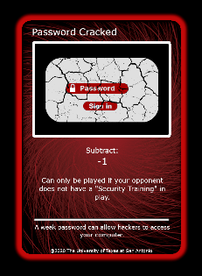
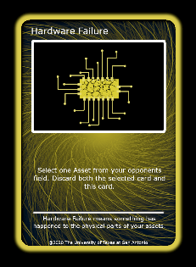
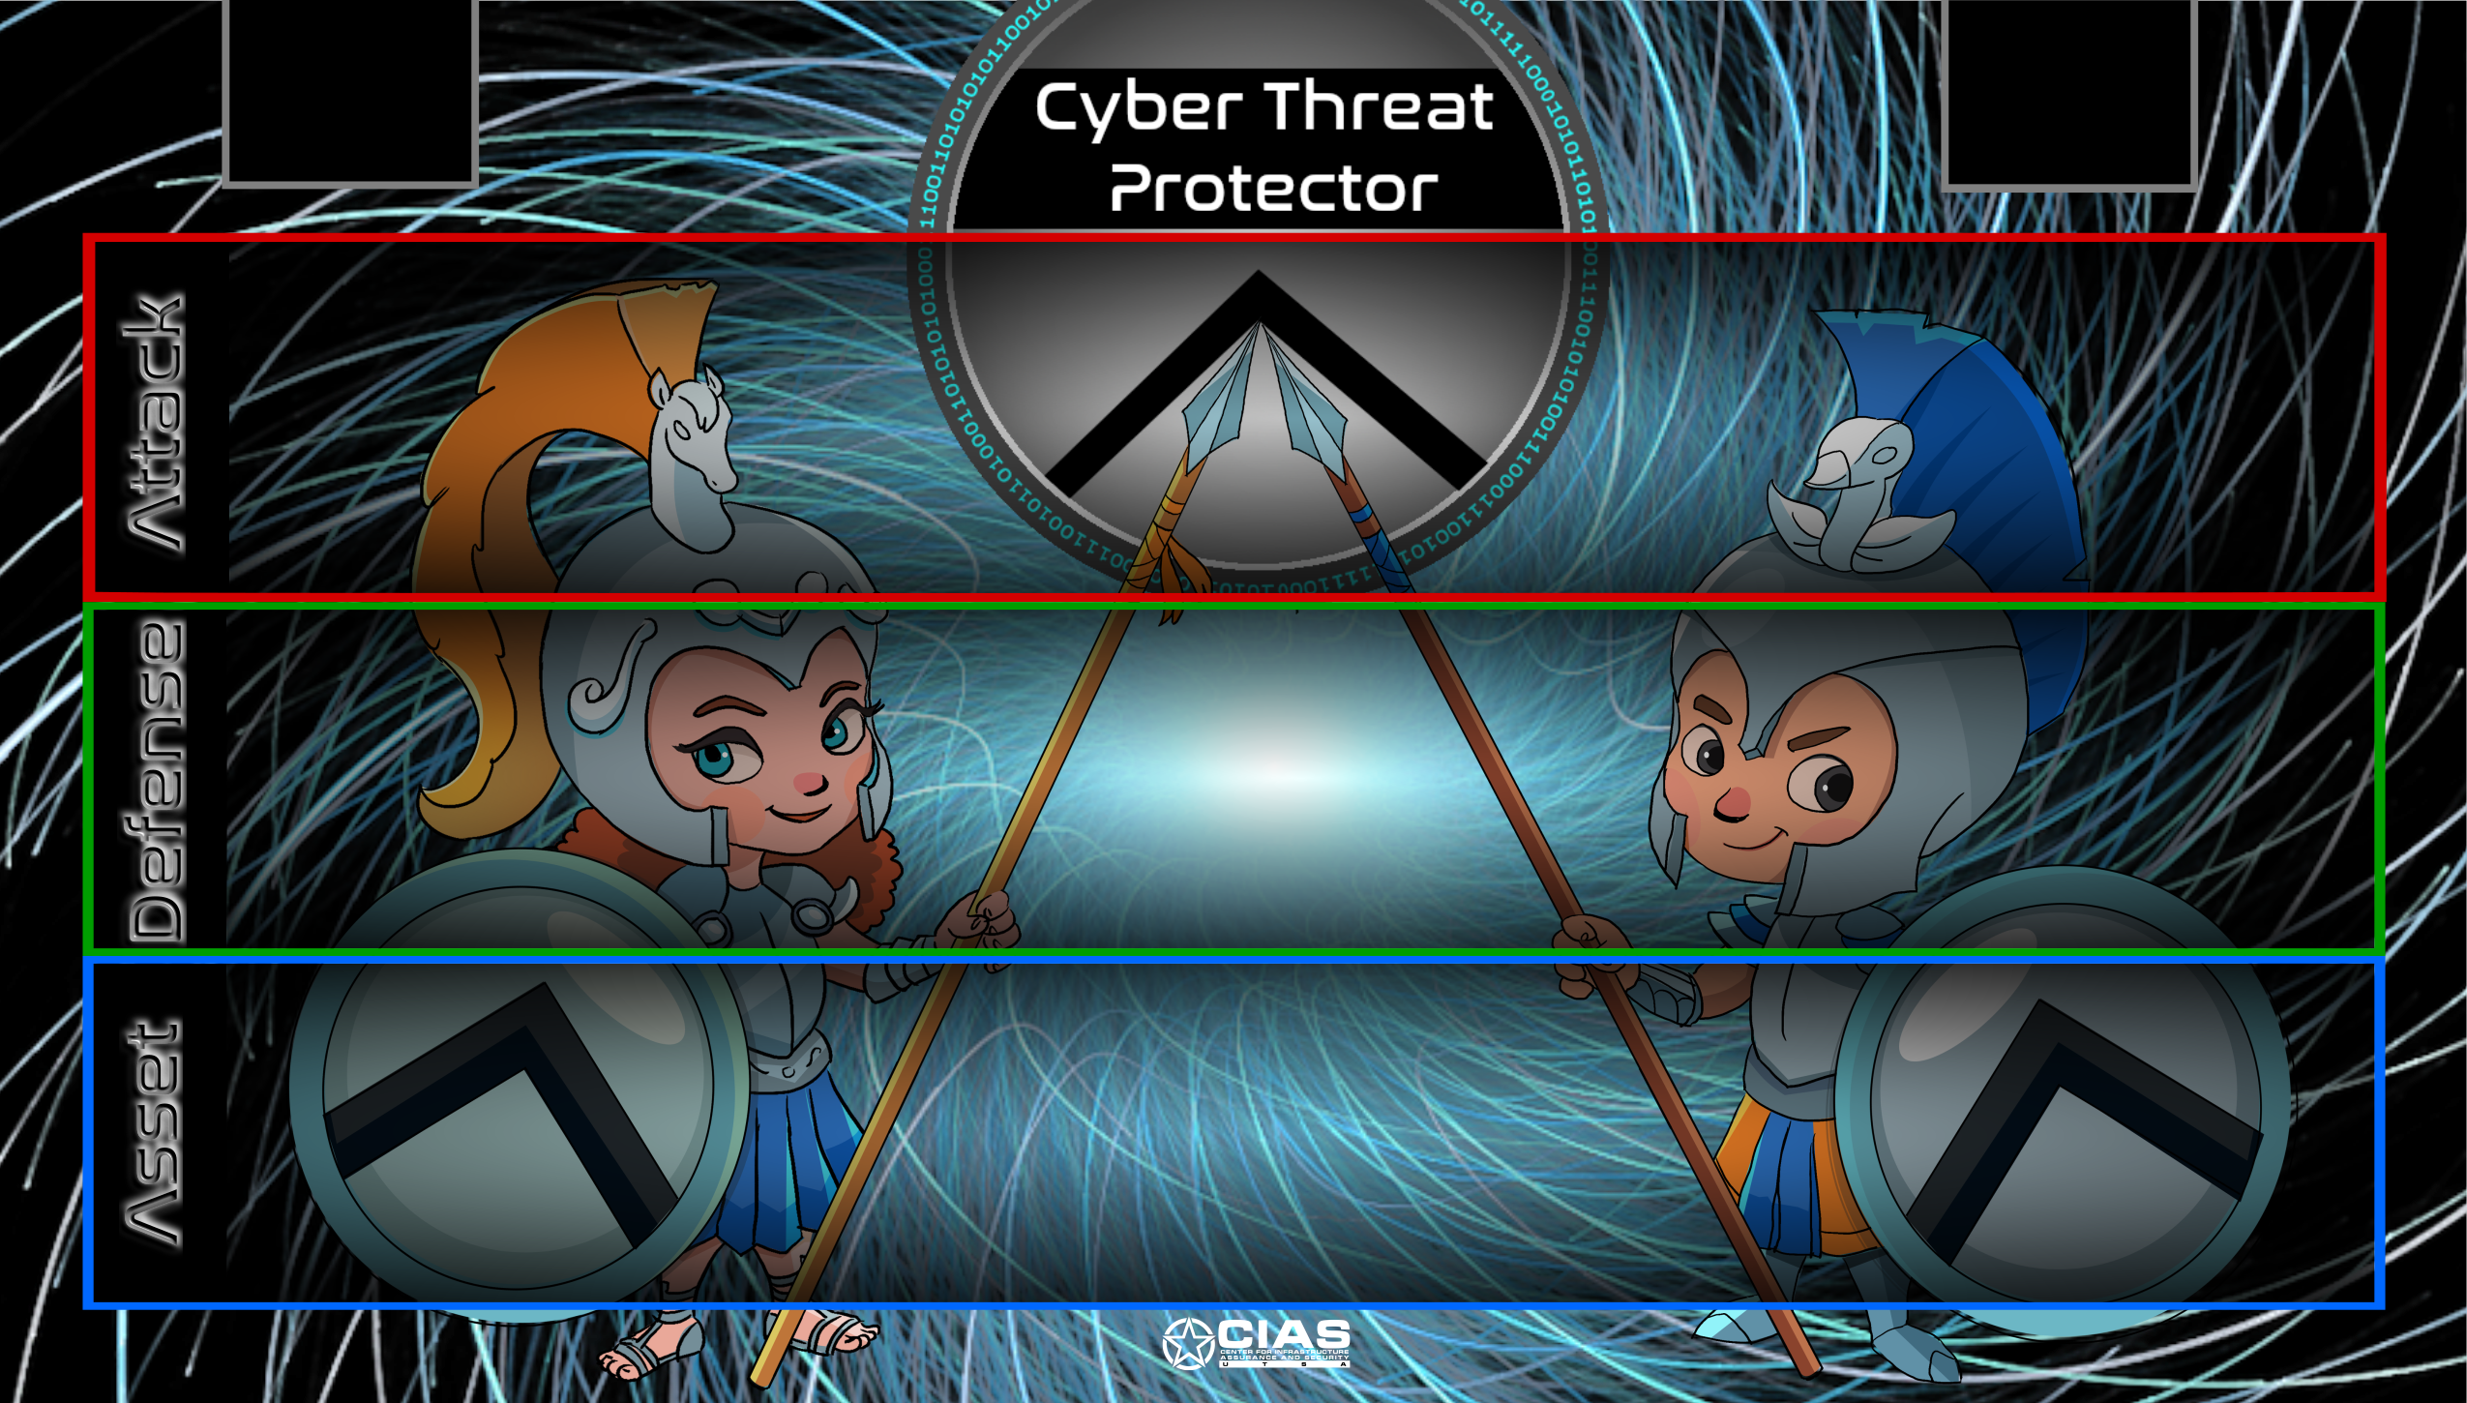
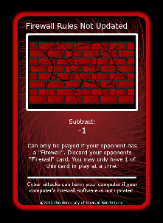
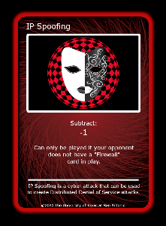
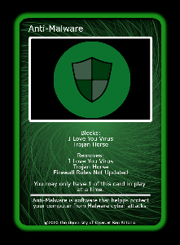
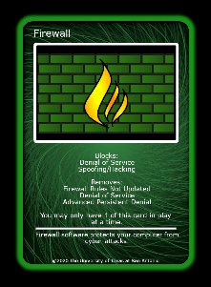
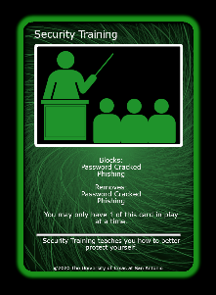
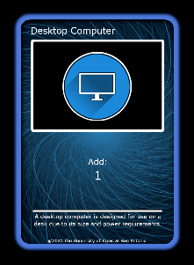
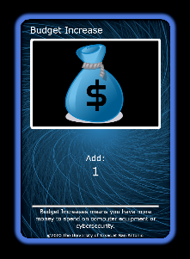
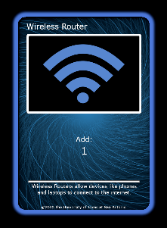
Game Play Layout (for player one)
Shared Draw Pile
Shared Discard Pile
Player One targeting player two with these attack cards

Slide 8
Getting Started: Each Player Does the Following…
Open your pack of Cyber Threat Protector cards. One deck is shared between two players.
Shuffle your deck,
Place the decks between you and your opponent to share. (This deck is the draw pile)
Decide the order of who is going first and who will go second,
Write your names on a score sheet,

Slide 9
How do you play?
Turn-based game.
Each player draws five cards from the draw pile/deck (player 1 draws first)
A player should never have more than 5 cards in their hand
Player One
On the first turn only, only player 1 can play up to 4 cards from their hand
This is the only time that a player will play more than 3 cards. Each round after this, both players can only select up to 3 cards to play
Player 1 discards all un-played cards into a new pile (face up) – called the discard pile
Both players share the discard pile
Player 1 then draws 5 cards from the draw pile, ending their turn

Slide 10
How do you play? Continued.
How do you play?
Player Two
Player 2 plays up to 3 cards from their hand
Once player 2 plays their cards, they will then discard all un-played cards into the discard pile
Player 2 then draws 5 cards from the draw pile, ending their turn
End of Round
When Player 2 finishes their turn, round one ends
Both players determine their score at the end of the round

Slide 11
Scoring
Score Sheet
Names | Player 1: | Player 2:
Round 1
Round 2
Round 3
Round 4
Round 5
Round 6
Round 7
Round 8
Round 9
Round 10
Round 11
Round 12
Round 13
Round 14
Round 15
Round 16
Round 17
Round 18
Round 19
Round 20
After the second player finishes their turn, both players must look at the cards on the field to determined how many points you’ve gained or lost.
Each Blue card = Add 1 point
Each Red card = Remove 1 point from your opponent
The first player to 20 points wins! (no score can go below 0 points)

Slide 12
Scoring Example
Player 2 will lose 2 points
Player 1 gains 3 points

Slide 13
Reminders
Common Terms
Read Your Cards. Some cards may only be played if your opponent has a specific card on their playfield.
Players must discard all cards in their hand and draw 5 cards at the end of their turn.
20 points to win (no negative points).
Play field: The area you or your opponent plays cards. Your play field is the area directly in front of you, while your opponent’s play field is the area directly in front of them.
Discard pile: The shared deck that you and your opponent place your discarded cards.
Draw pile: The shared deck that you and your opponent draw cards from.

Slide 14
Thank You
For examples of a full round of play, download the rulebooks or watch our video tutorials at CIASGaming.com. Order your free classroom set via cias.store

