Slide 1
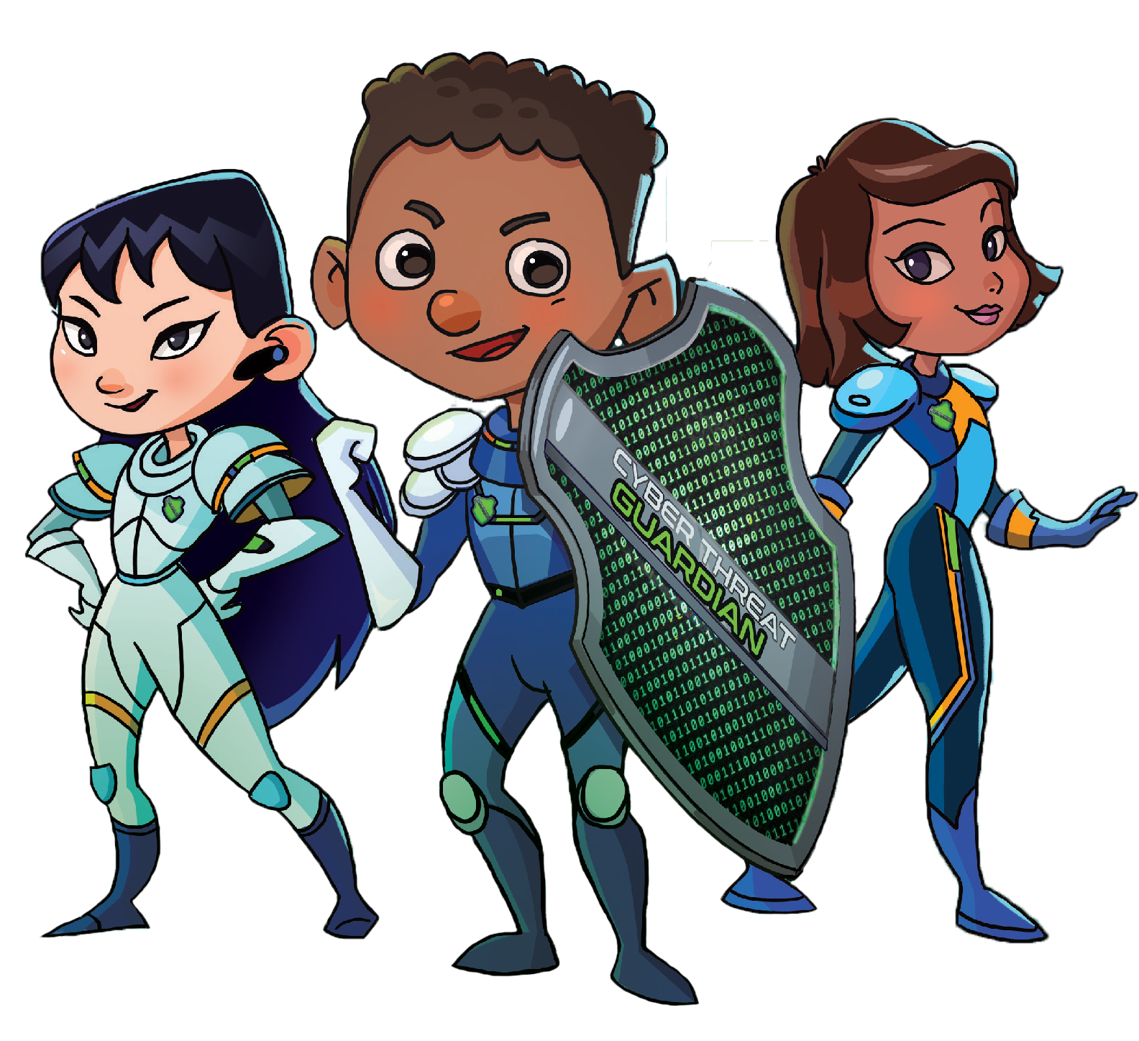
Learn to Play Cyber Threat Guardian

Slide 2
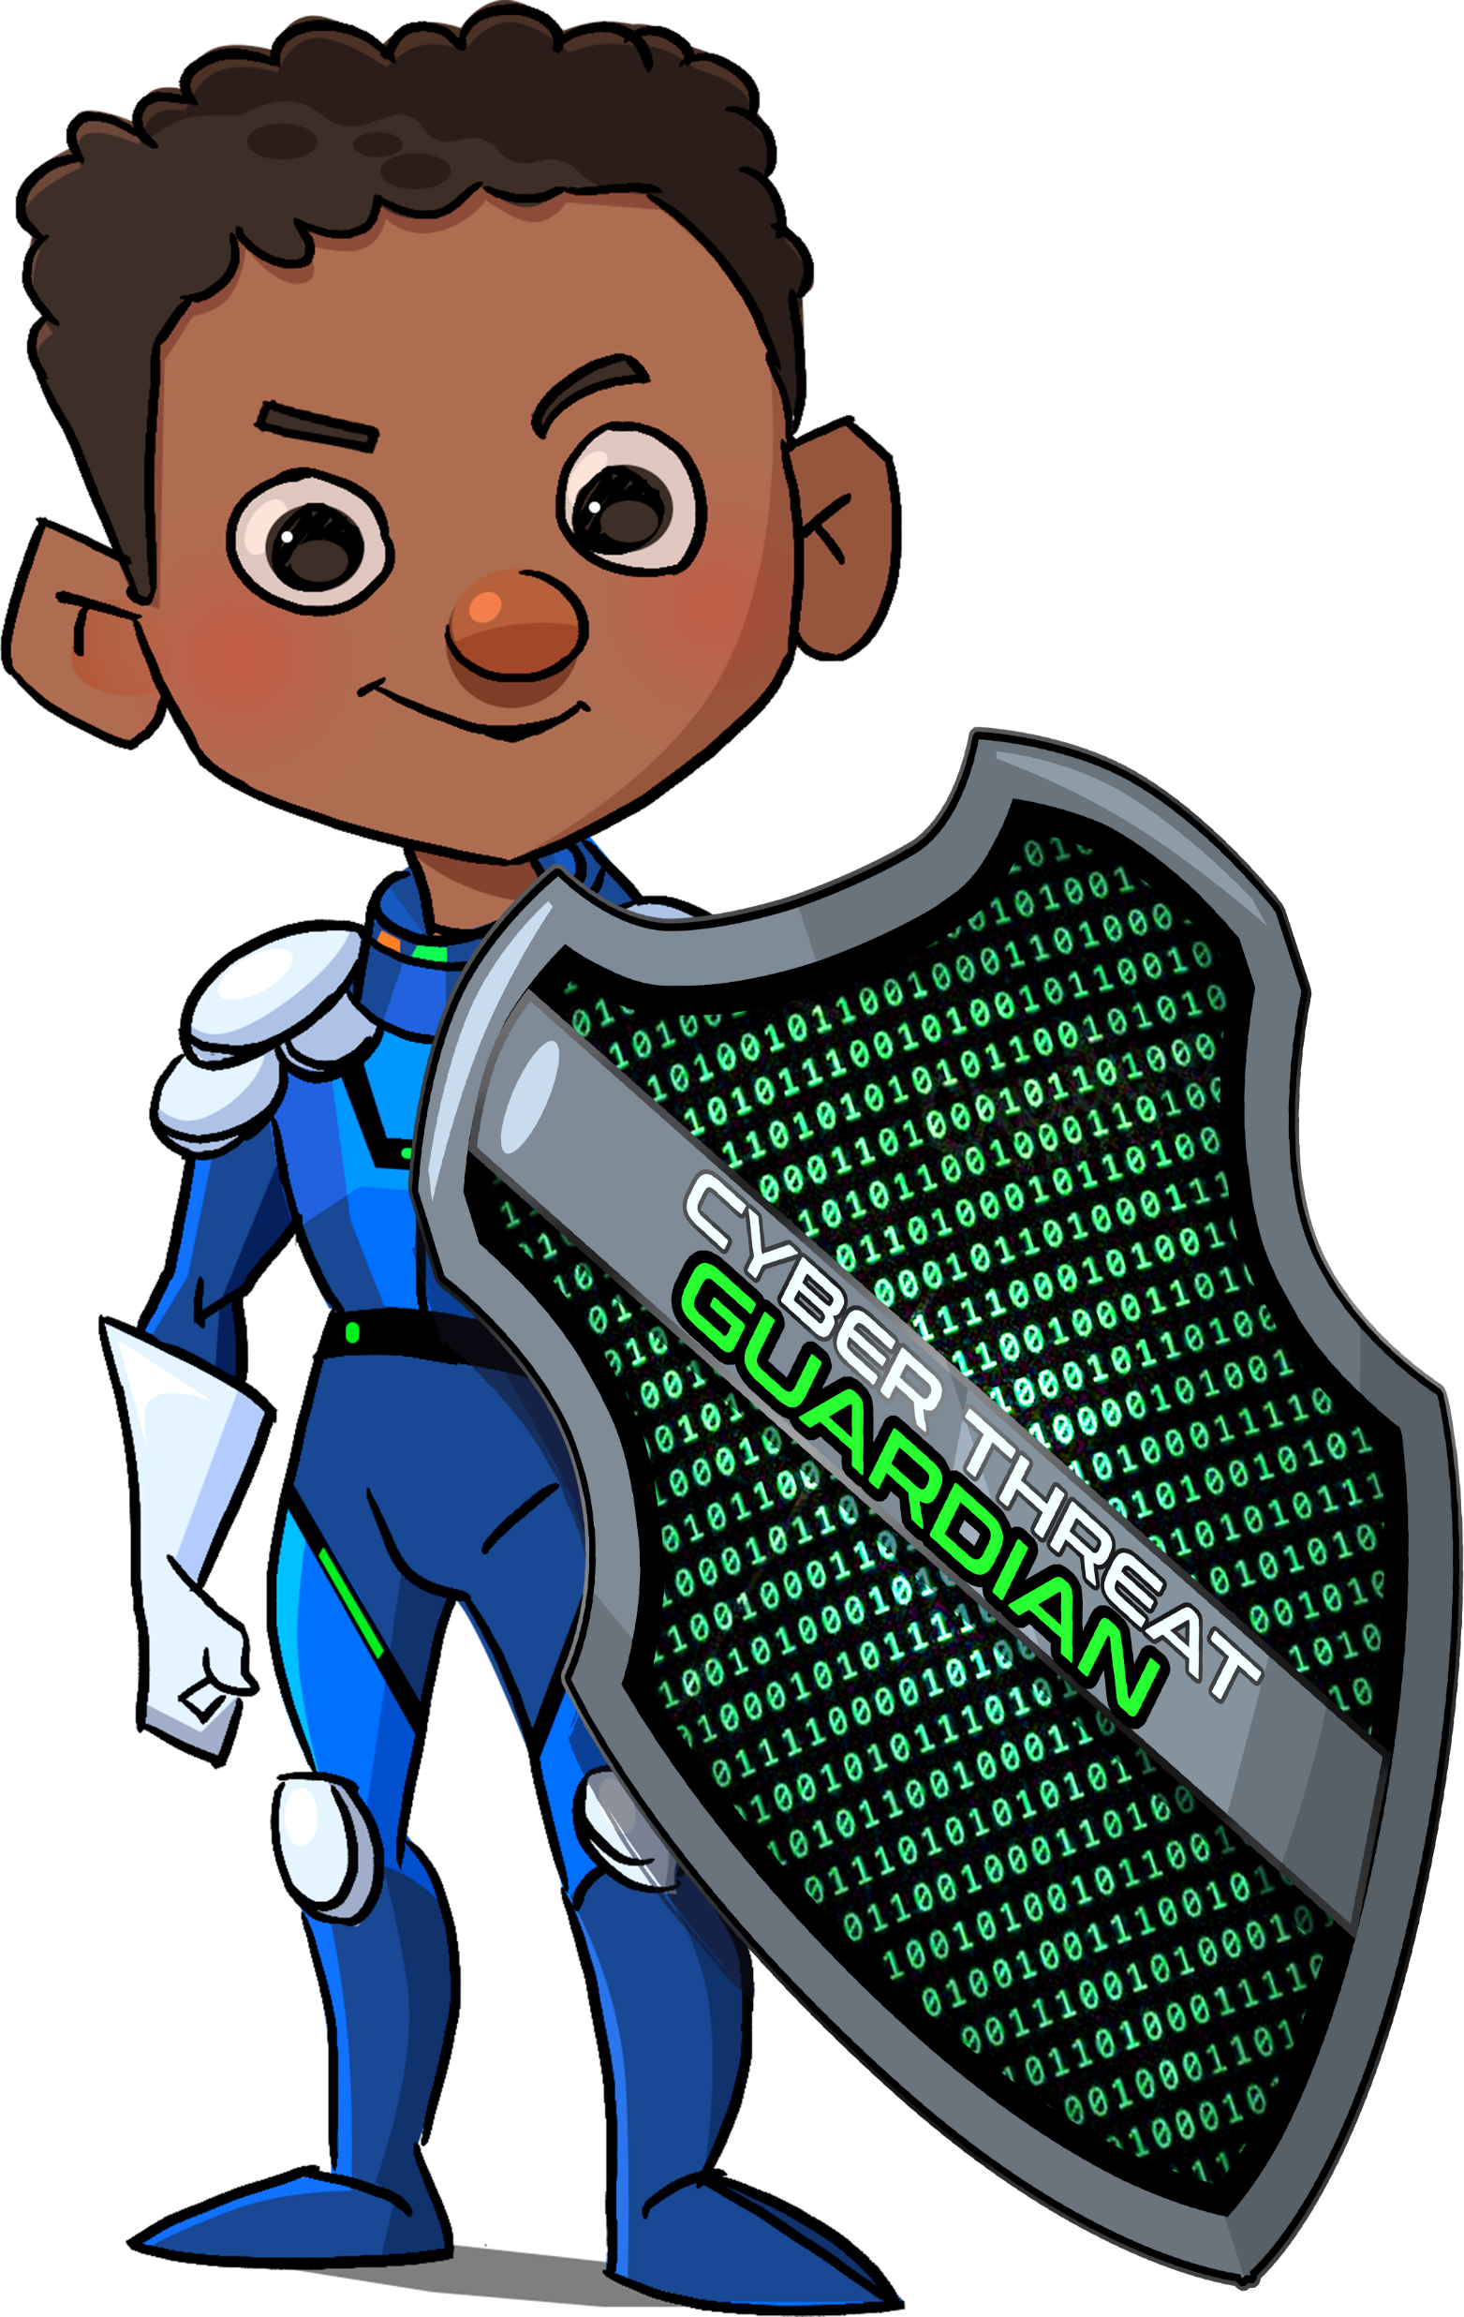

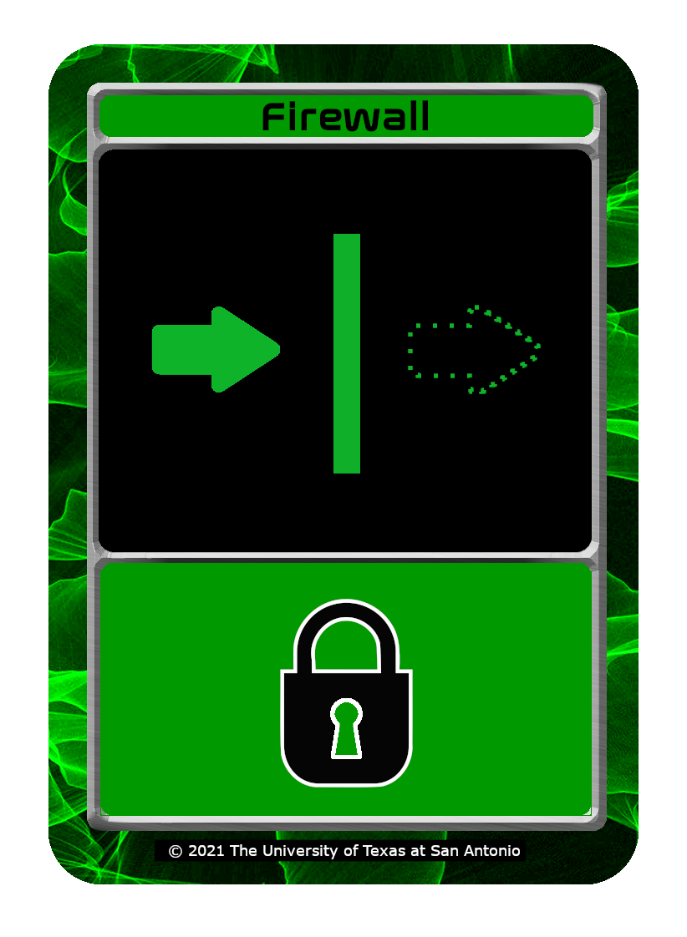

Core Concept of Cyber Threat Guardian
Create a network of Assets
Build Defenses to prevent malicious Attacks
Asset
Defense
Attack

Slide 3

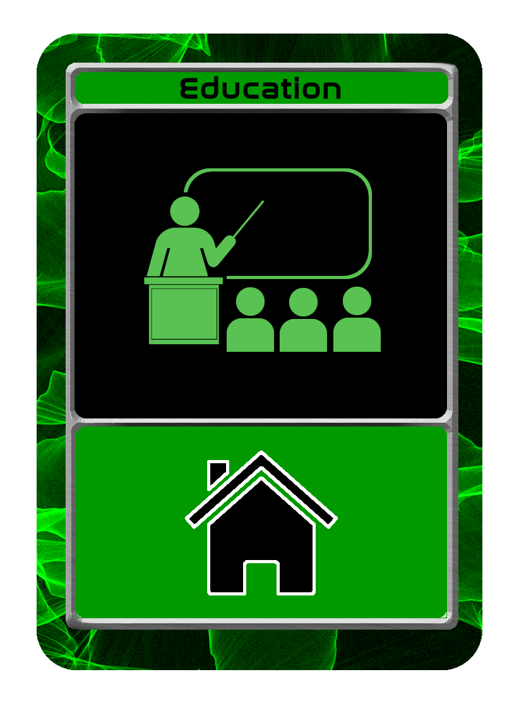
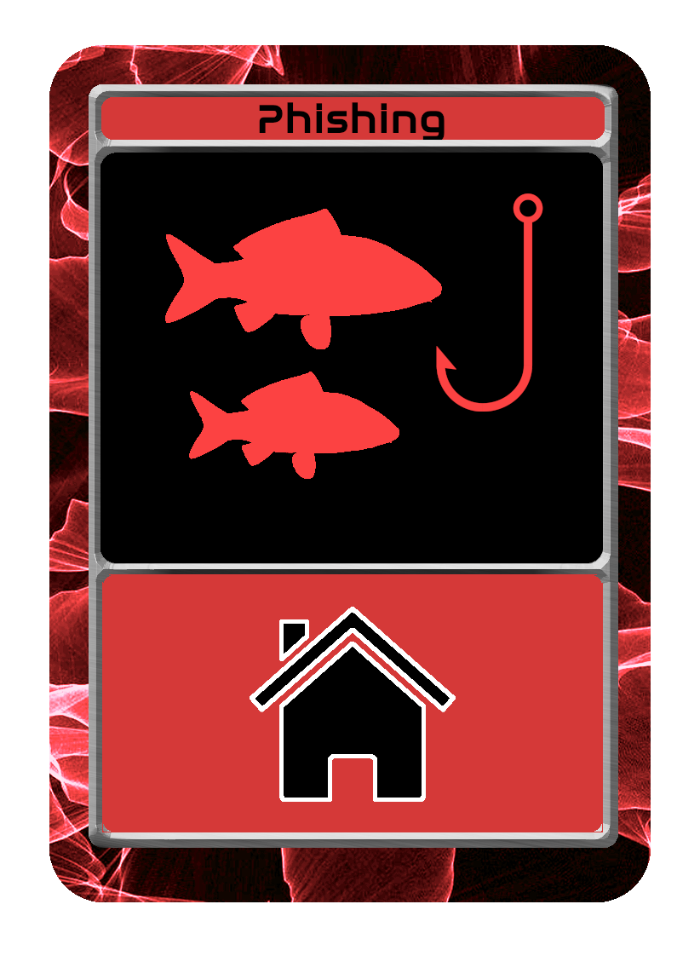
What do the cards do?
Each card has pictures and icons that are used for quick reference
Three basic types of cards:
Asset
Defense
Attack
The foundation of your computer network
Protects your network from attacks
Malicious threats that can exploit your network

Slide 4
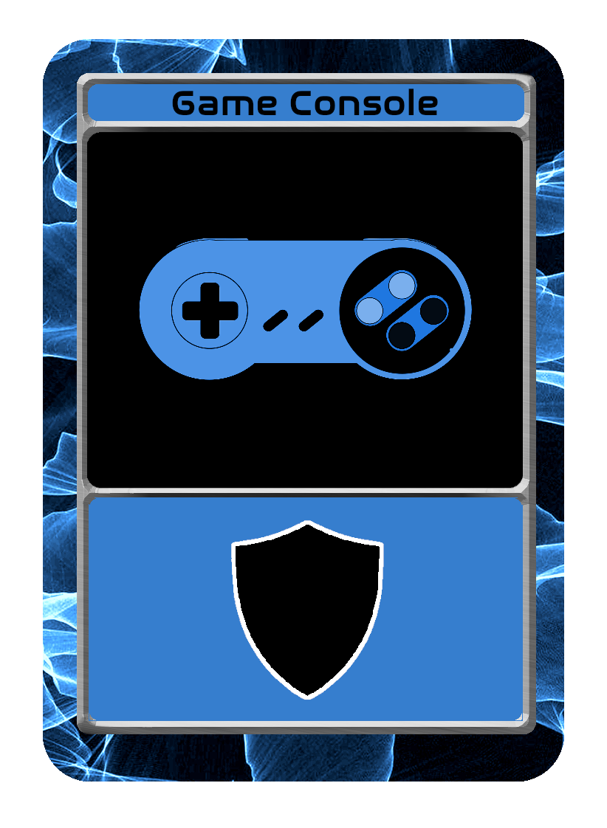

Anatomy of a Card
Card Name
Card Image
Gameplay Description

Slide 5
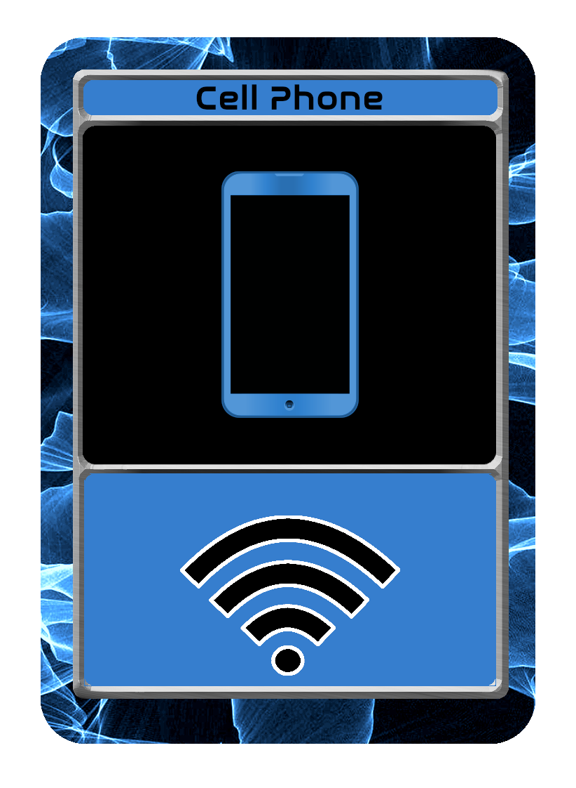
Card Types – Assets
These cards represent the things you may have in your home like a desktop computer, cell phone, game console or private information about yourself. These are the cards you need to protect.

Slide 6
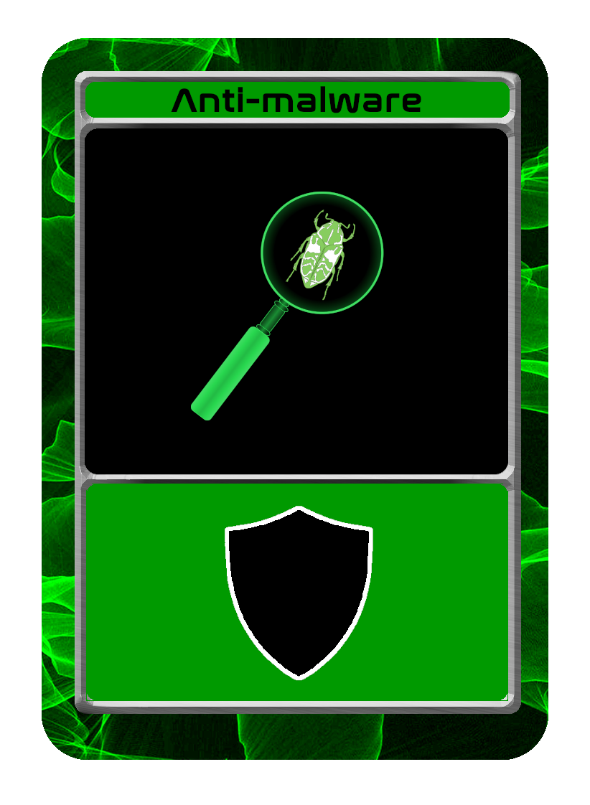


Card Types – Defenses
Defense cards represent the systems used to protect devices, such as firewalls, anti-malware, encryption and education. These are the cards used to protect the asset cards. Defense cards will prevent the attack cards from removing asset cards.

Slide 7


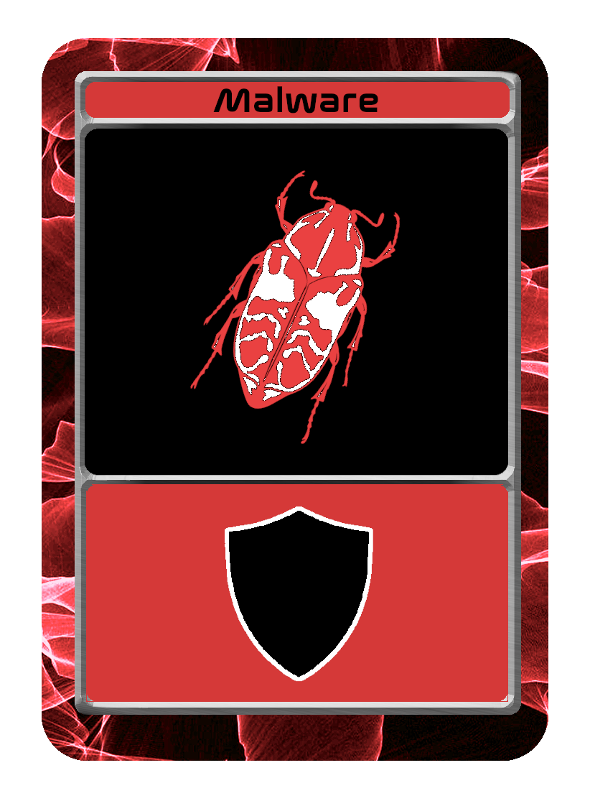

Card Types – Attacks
Attack cards are represented by the various ways hackers, or bad guys, can harm computers, game consoles, mobile phones or steal private personal information. Attack cards will remove unprotected asset cards.

Slide 8
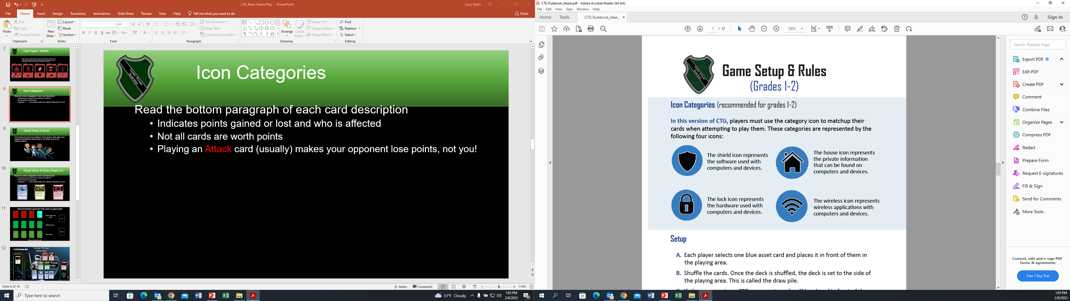
Icon Categories
Players use the category icon to matchup their cards when attempting to play them.
Card categories are represented by the following four icons to the right:

Slide 9
Game Setup & Rules (Grades 2+)
Shuffle the deck of cards. Once the deck is shuffled, the deck is set to the side of the playing area. This is called the draw pile.
Draw
Pile
Discard
Pile
Player’s
Defense
Card
Player’s
Defense
Card
Player’s
Asset
Card
Player’s
Asset
Card
Player’s
Asset
Card

Slide 10
Game Setup & Rules (Grades 2+)
Defense cards are placed above the asset cards with the same category icon.
Opponent Attack cards are placed above asset or defense cards of the same category.
Notes:
For demonstration purposes, the red attack cards are facing the opposite direction of the asset and defense cards. This is a reminder that the attack cards are targeting the opponent. Remember, in this setup, the attack cards do NOT need to match the icons on (my) field. The attack card icons need to match up with the opponent’s icons.

Slide 11
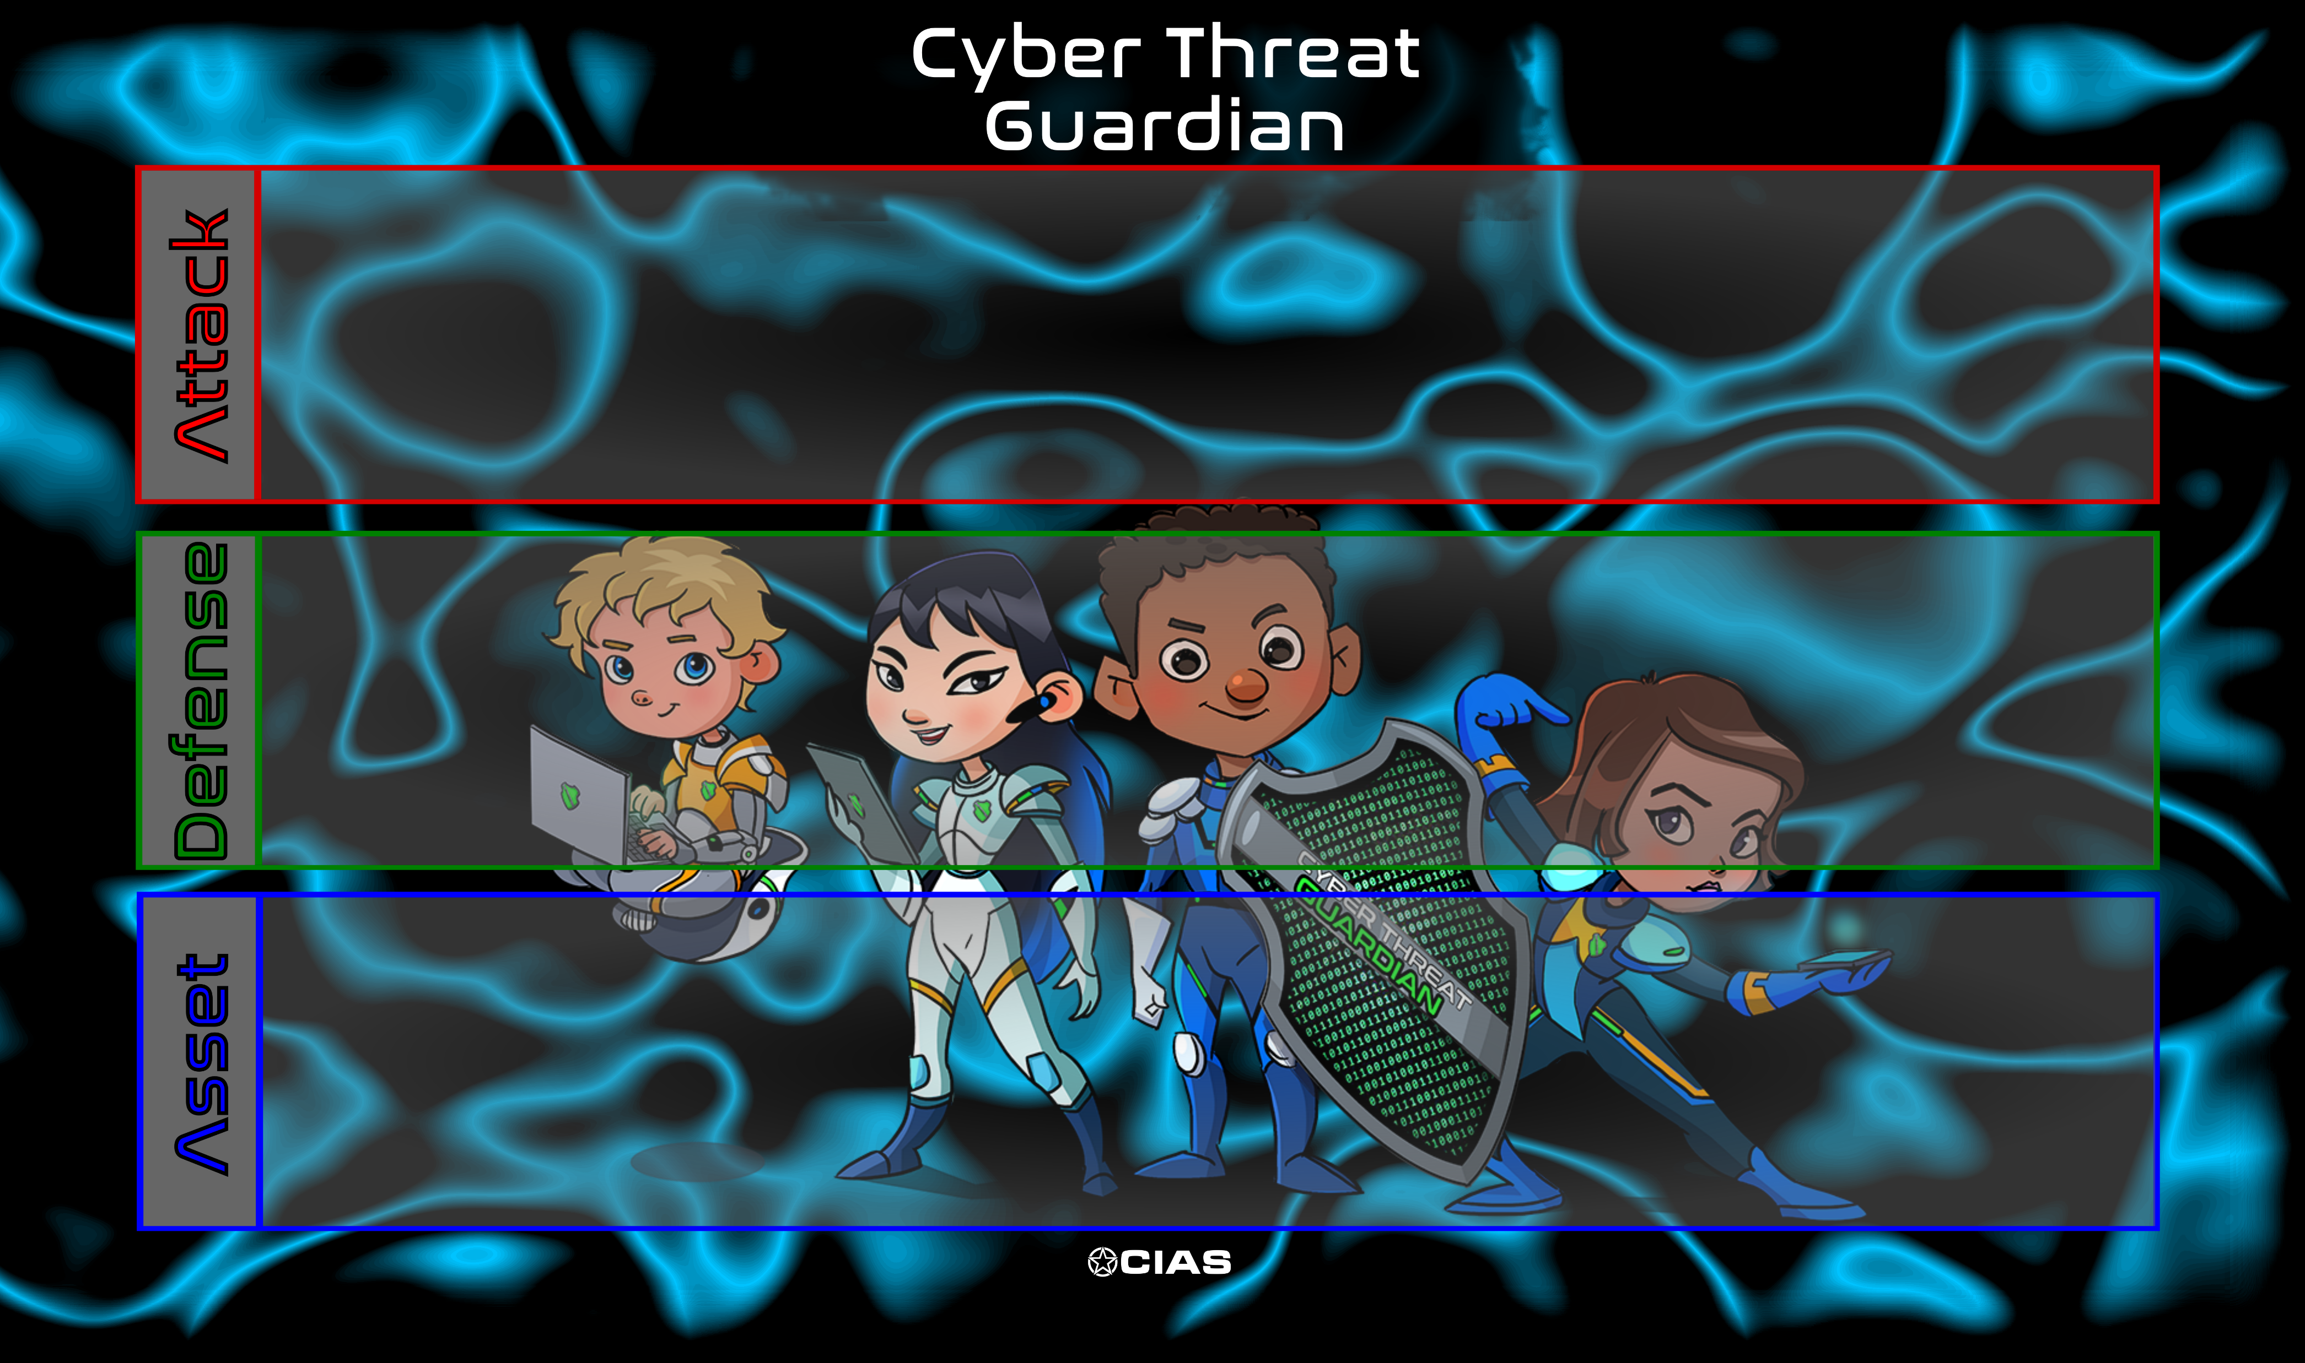
Game Play Layout

Slide 12
Getting Started: Step 1
Both players draw two cards from the draw pile. It does not matter who draws first. This is the only time both players draw two cards during a turn.
Cards may only played in the following order: Blue Asset, Green Defense, Red Attack. For example, a Defense card cannot be played until an Asset card has been played first. Consider the cards on the right. One column is correct. One is wrong. Which one?

Slide 13
If the card is a blue asset card, the player places the card in front of them in the playing area.
If the card is a green defense card, the player places the card in front/above any blue asset card with the same category icon in their playing area that does not already have a green defense card protecting it.
Getting Started: Let’s Illustrate
Notes:
NOTE: A player cannot “stack” defenses on top of an asset card. Only one defense card is permitted per asset card.

Slide 14
Getting Started: Let’s Illustrate
If the card is a red attack card, the player can use it to remove any green defense card with the same category icon OR any unprotected blue asset card of their opponent with the same category icon. The icons of an attack card must match icons that your opponent has in play. Protected blue asset cards cannot be removed until the green defense card protecting them is removed first. Which cards on the right can the attack cards remove?
Notes:
Which cards on the right can the attack cards remove? The Wireless Attack card can remove the Encryption Defense card. The Phishing Attack card can remove the Private Information Asset card.

Slide 15

Continued Play and End of Game
Step 2:
Play continues with each turn. After each player has completed a turn, the “round” is over.
Only after the round is complete can both players draw one card and attempt to play that card during their new turn.
Step 3: Once players use all the cards in the shared draw pile, the game ends.
Note: It’s possible that a player may not be able to place any cards in the game’s play area. Any cards not played should be placed in the discard pile to complete your turn.

Slide 16
Scoring: It’s Simple!
The player with the most point wins.
Players count the number of blue asset and green defense cards that they have in front of them. Each card is worth 1 point.
How many assets and defenses are shown to the left?
Answer: 6 cards total = 6 points

Slide 17
Thank you
For examples of a full round of play, download the rulebook or watch our video tutorials at CIASGaming.com.

