Slide 1
Learn to Play Cyber Threat Defender

Slide 2

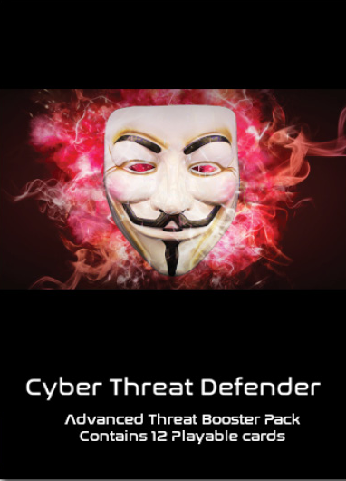
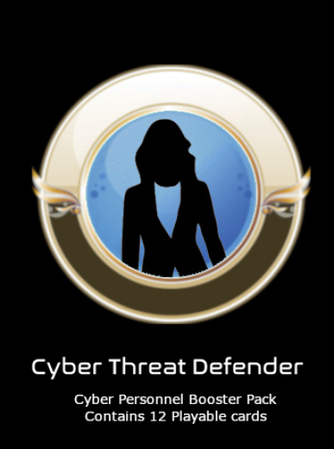
What is Cyber Threat Defender?
Cyber Threat Defender (CTD) is a competitive, collectible card game similar to games, such as Pokémon or Magic the Gathering. Through the use of booster packs, players can customize their decks to develop different strategies to defeat their opponents.

Slide 3
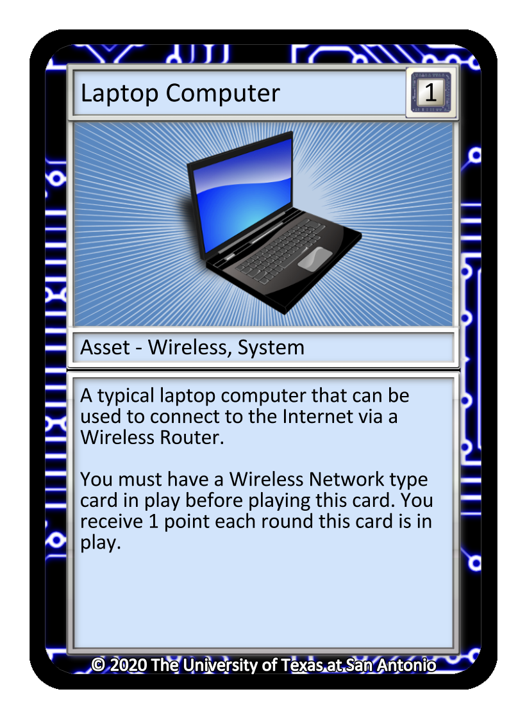
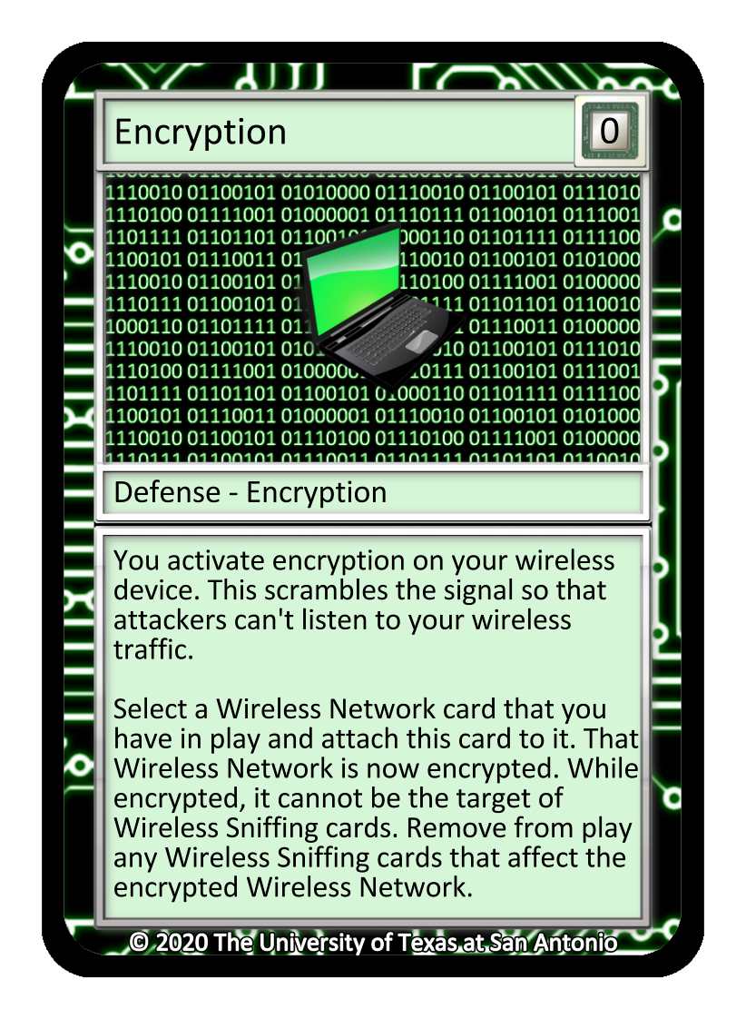
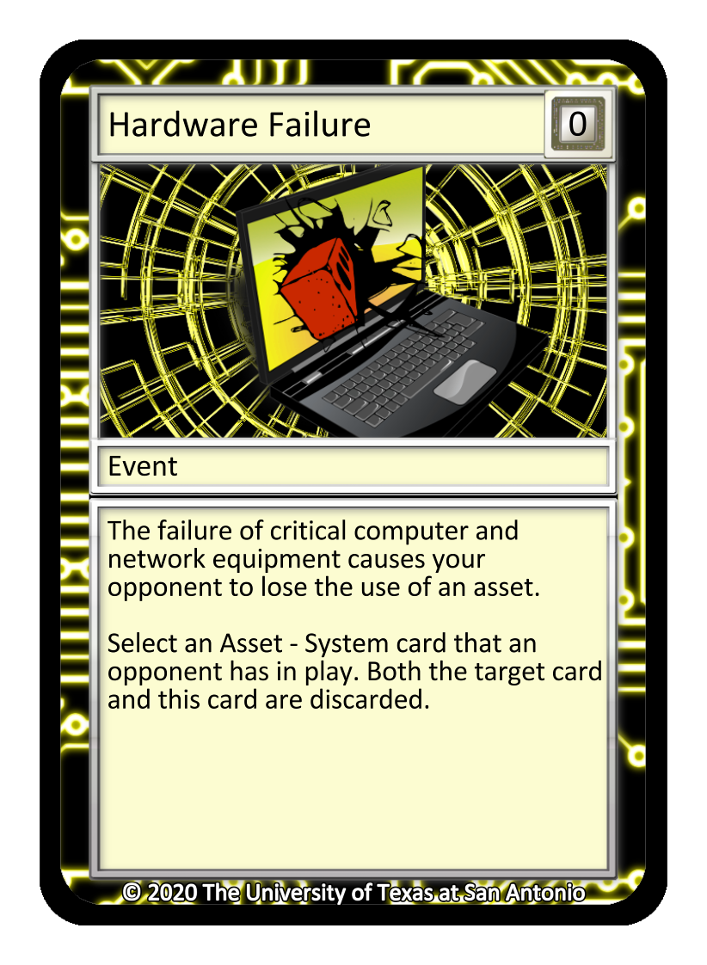
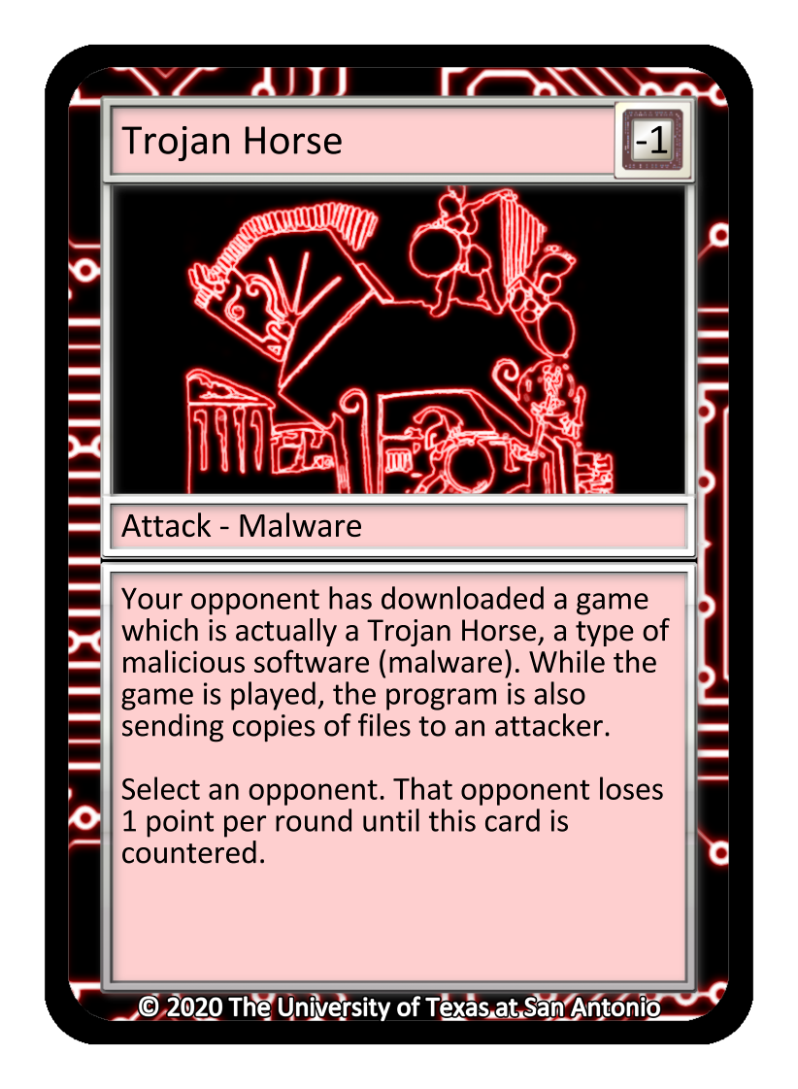
Cyber Threat Defender Objective?
Players create a network of Assets and build Defenses to prevent Attacks and from opponents and Events are various things that can happen.
Asset
Defense
Event
Attack

Slide 4
Card Types
The four basic types of cards:
Assets: The foundation of your computer network
Defenses: How you protect your network from attacks & disaster
Events: Random happenings, for better or worse
Attacks: Malicious attempts against your network
Asset
Defense
Event
Attack

Slide 5
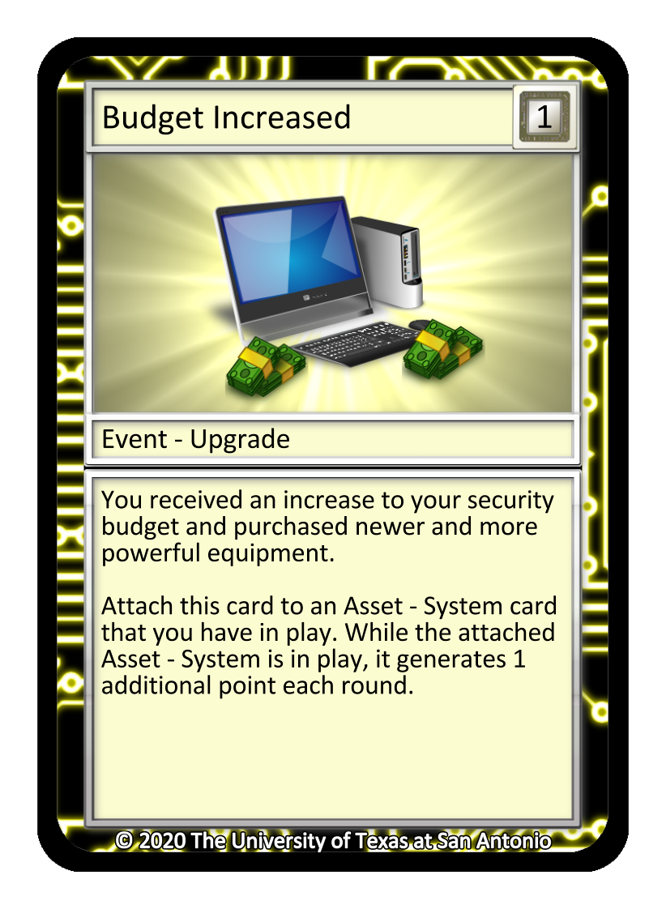
Anatomy of a Card
Card Name
Point Value
Card Type
Card Description
Card Effect Details
NOTE: Some cards affect scoring indirectly; always read the Card Effect Details for a full understanding of how a card affects scoring
Notes:
Every card features five common areas. The name of the card is always at the top, with the point value to its right. The card type is below the image – this is a critical part of the card and helps the player identify other cards it may interact with during a turn. The card description is a valuable learning element for both teachers and students; this first paragraph provides a brief description of what the “card name” relates to in the real world. The second paragraph details the card’s effects – how the card is to be played within the game. If you read the card, you know the card. ​

Slide 6
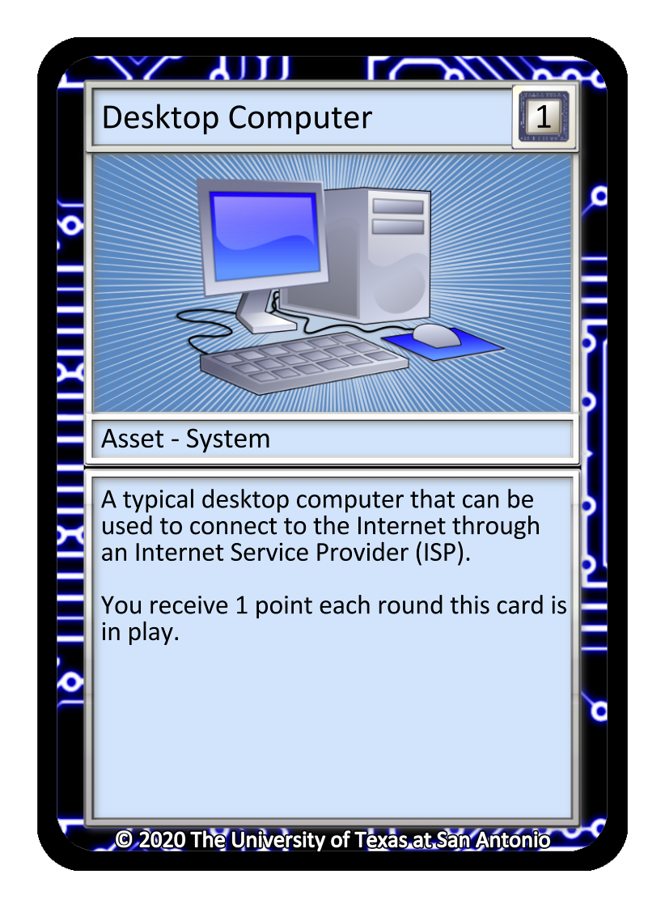
Common Card Mechanics – Gain Points
Notes:
This is an example of how a player may gain points within a turn. This shows two different assets and an event. ​
Note: The Budget Increased card can only be played when an “Asset – System” type card is already in play. It must be “attached” to this Asset – System. It can be attached to either the Desktop Computer or Laptop Computer asset cards, since both are Asset – System type cards. The next slide illustrates.​

Slide 7
Common Card Mechanics – Gaining Points
Notes:
This slide illustrates how a Budget Increased card has attached itself to the Desktop Computer card. Even though we are showing two Asset – System type cards, it can only attach to one card.​
Notice why the Desktop Computer was selected by examining the other card. The Laptop Computer card cannot be played during a turn yet because it requires a Wireless Network type card to already be in play. The Budget Increased Card could only be played with the Desktop Computer card.​

Slide 8
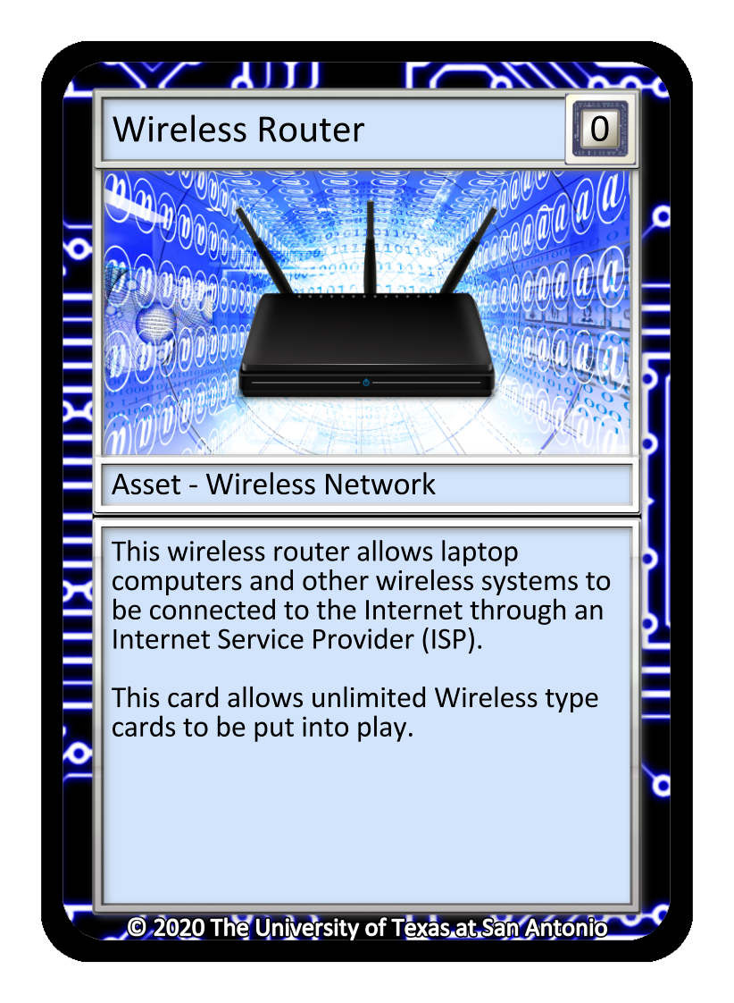
Common Card Mechanics – Gaining Points cont.
Notes:
Now we can see a Wireless Router card. This card type states it is an “Asset – Wireless Network” card, which now allows the Laptop Computer card to be played.​

Slide 9
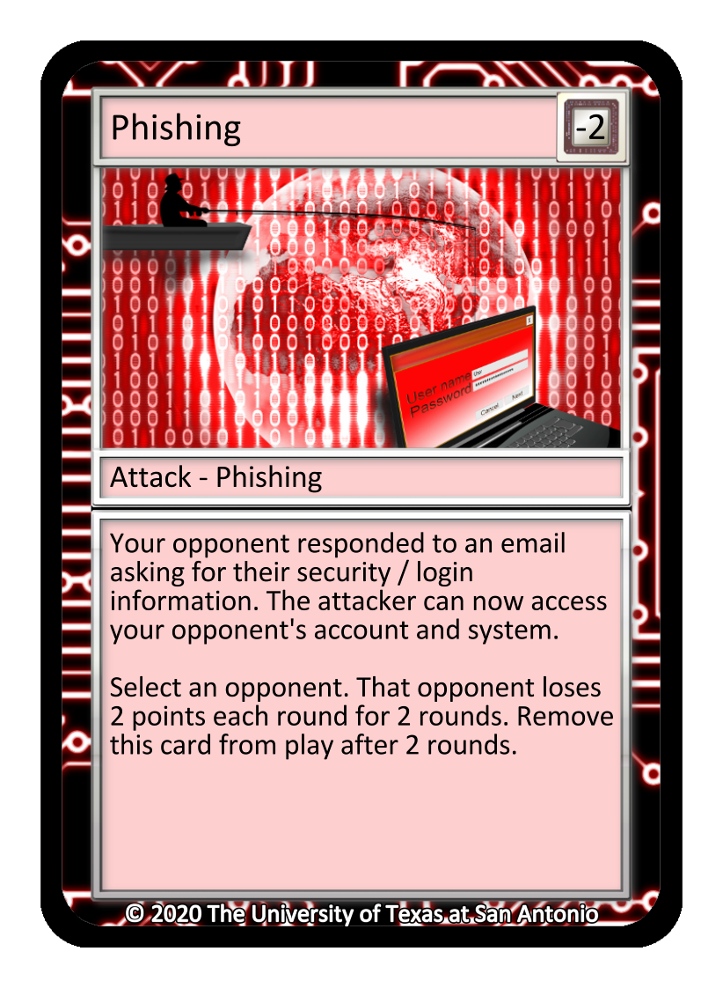
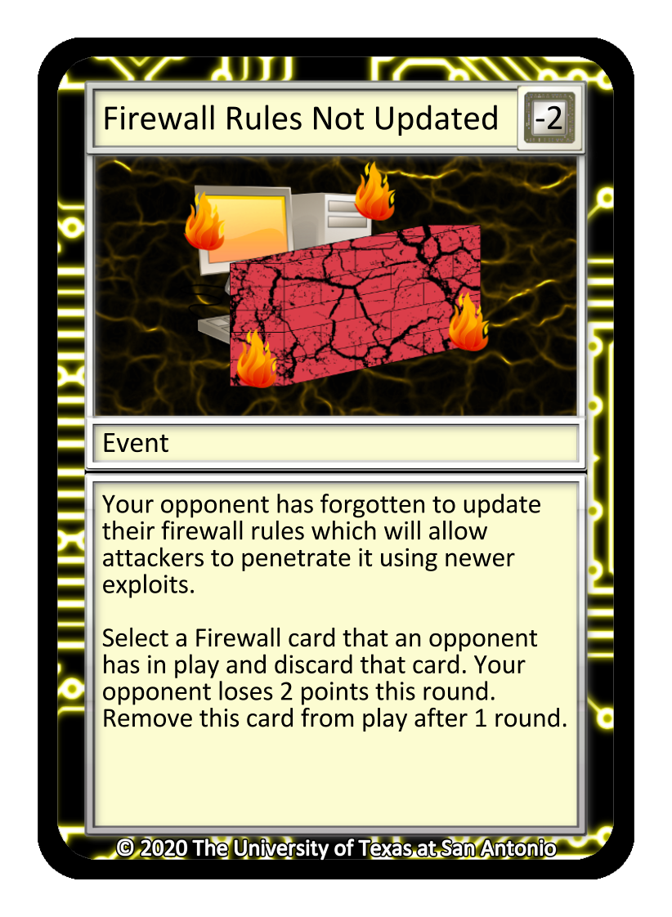
Common Card Mechanics – Opponent Point Loss

Slide 10
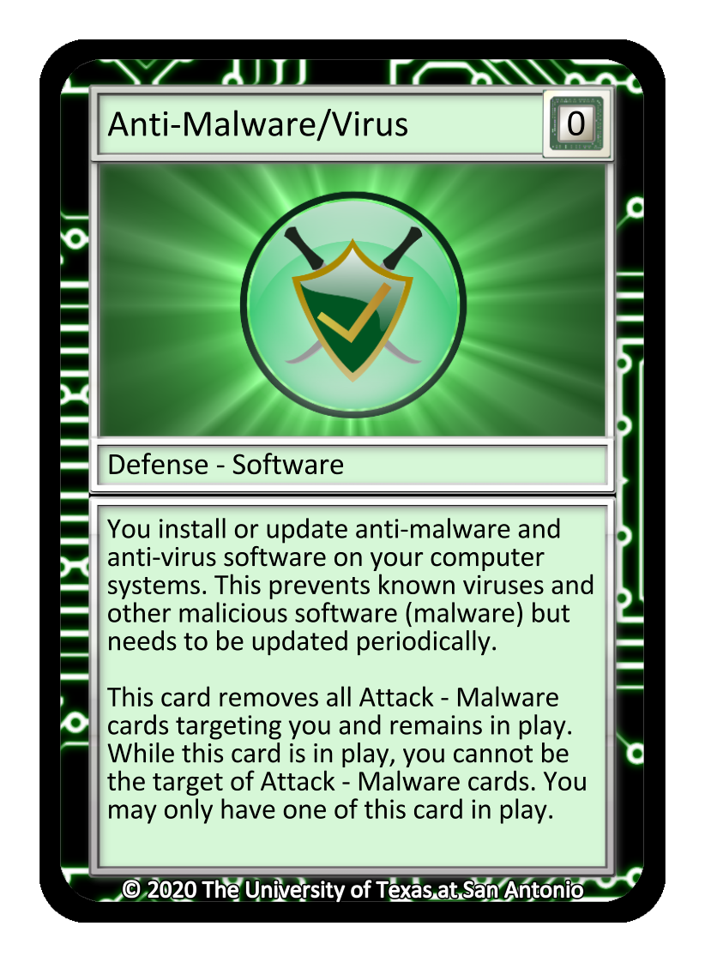
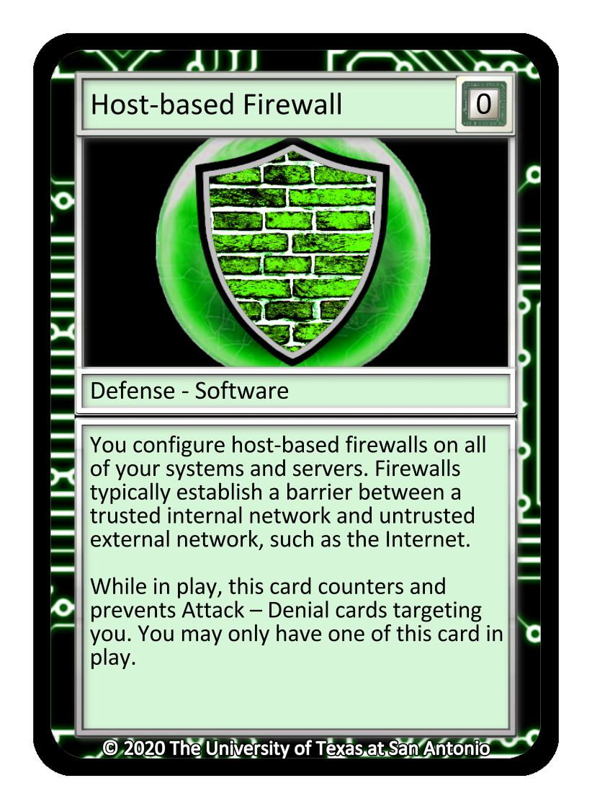
Common Card Mechanics – Card Removal & Immunity

Slide 11
The Value of Cards
Read the bottom paragraph of each card description
Indicates points gained or lost and who is affected
Not all cards are worth points
Playing an Attack card makes your opponent lose points, not you!
Notes:
While the point value of a card is always indicated in the top right corner, but remember to read the second paragraph throughout game play. The second paragraph can reinforce and/or introduce point values of individual cards.​

Slide 12
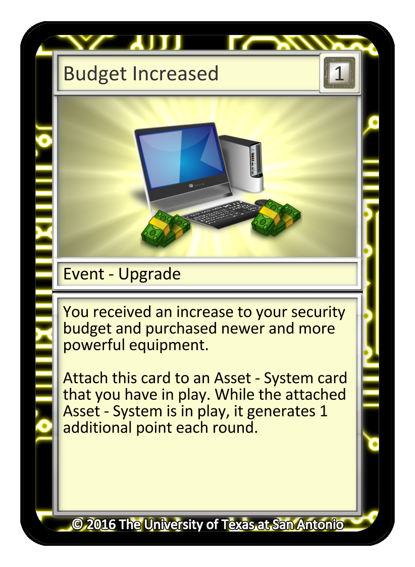
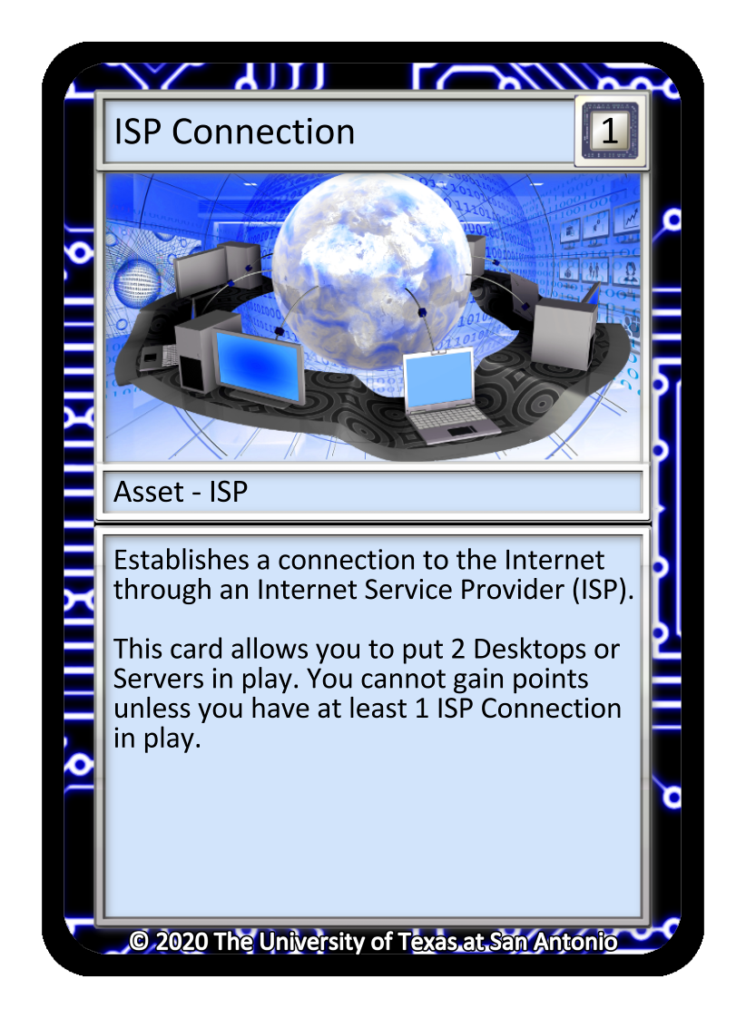
Recommended Layout for Play
We recommend that players keep all cards they play in their own area
Any Attack or Event card in play can be viewed as targeting the opponent (where applicable)
Note: Event cards can either hinder your opponent or benefit yourself. Read the cards carefully

Slide 13
Recommended Layout for Play (with no game mat)
Attack and Event Cards
Discard
Defense Cards
Draw
Asset Cards
Player’s Network Area
Notes:
The majority of students playing Cyber Threat Defender will not have access to their own personal game mats. Mats are a great asset and visual aid to keep the play area organized, but they are not required to play the game. Here we can see the recommended layout for play. The asset cards should always be closest to the person with the defense card placed right above them. Remember, the defense cards are protecting the assets, so this provides a visual reinforcement of that concept. The attack cards are actually targeting the opponent, so these are placed above the assets and defenses. Most event cards (that are designed to hinder the opponent) are discarded immediately after use, so these can be placed in either with the attack cards or temporarily placed off to the side.​

Slide 14
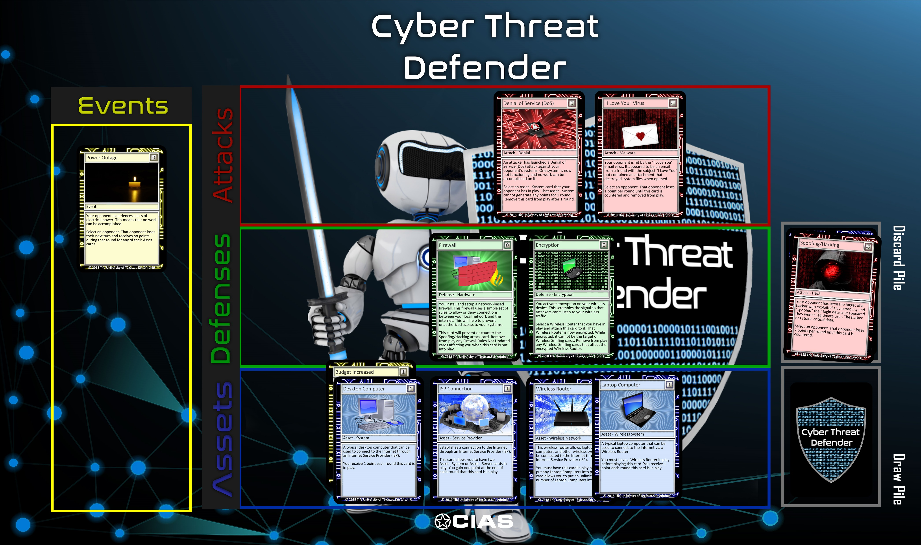
Cyber Threat Defender Game Mat with Cards

Slide 15
What is your strategy?
While you play, consider some of the following scenarios.

Slide 16

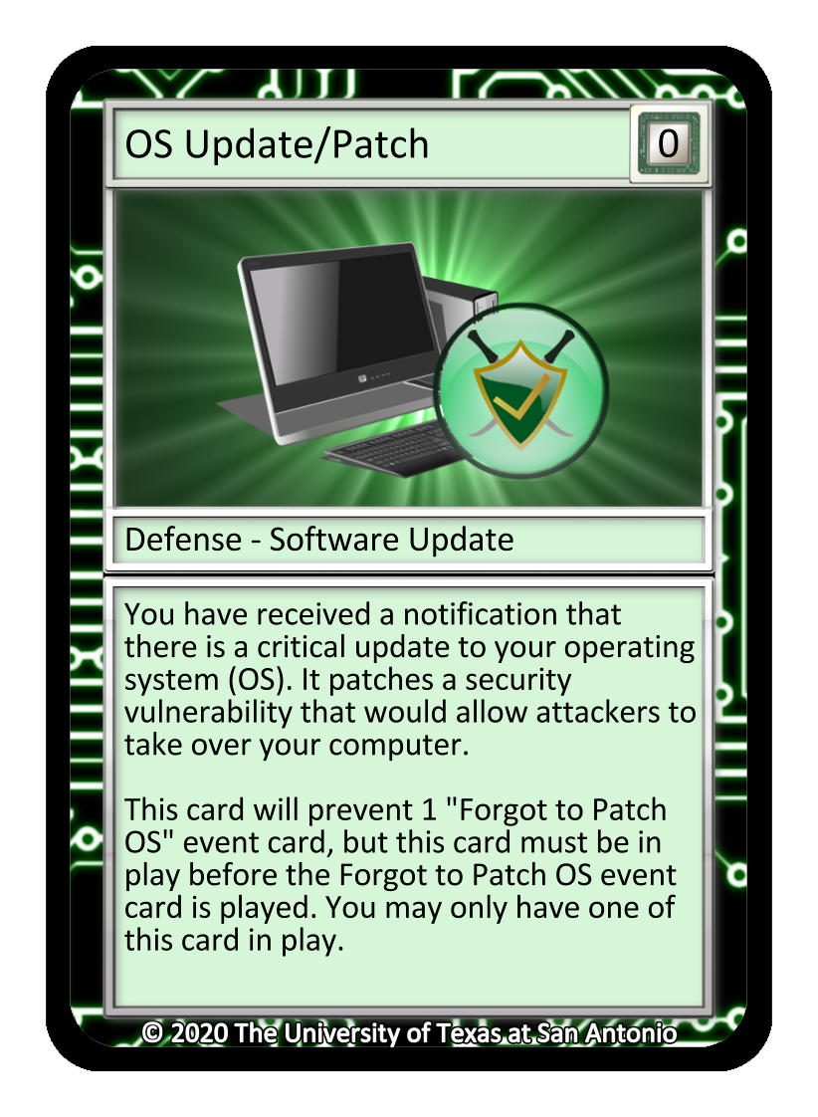
What is your strategy? Defense Cards
Placing defense cards as soon as possible.

Slide 17
What is your strategy for Defense Cards?
For example, if you are going to play a Wireless Router, you may consider playing an Encryption card to stay protected.

Slide 18
What is your strategy for Event Cards?
Event Cards can be played by either player at any time during a round. They can be crucial to helping you win.
Notes:
This illustrates the player at the bottom playing a Hardware Failure event card. They are targeting the asset that has a Budget Increased card attached to it. The Hardware Failure card removed both the Desktop Computer and Budget Increased card attached to it, costing the second player two points.​
NOTE: Event cards can be played whether it’s your turn or not. Consider these random events as “wild” cards. These can either help you or hinder your opponent.​

Slide 19
Getting Started: Each Player Does the Following…
Put into play: one Desktop Computer, one ISP Connection
“In Play” = face up on the table in your asset zone (the area closest to you on the table).
Note: You can play any one Asset – System and one Asset – ISP card type; however, the Desktop Computer and ISP Connection cards are the only playable options within the base deck.
Shuffle your deck
Draw seven cards to get started. You may look at your cards.
Notes:
The Asset – System and Asset – ISP cards represent your network. These two card types must be in play to have a “network” to defend as you get started.​

Slide 20
How do you play? (Drawing and Discarding Cards)
Turn-based game.
During your turn, you may play up to three cards from your hand if possible. Read the second paragraph fully.
Each card’s effect takes place immediately when played unless specified by the card.
The Event cards do not count toward this limit and can be played during either turn
When done playing cards, if you have more than five cards in hand, you must discard until you have five cards.
You choose any card in your hand to send to your discard pile and continue doing this until you only have 5 cards left in hand.
Notes:
NOTE: Knowing how many cards to draw after each turn can be the hardest rule to learn for new players. Spend time ensuring the players understand this rule. ​
Remember, any three cards (Asset, Defense, Attack) can be played per turn. This can be any combination – all Assets, all Defenses, all Attacks or a combination of the three types. The yellow Event cards do NOT count toward the three card limit that may be played. However, sometimes, a player may not be able to play up to three cards. This is okay. ​

Slide 21
How do you play?
Finally, draw two cards, and your turn immediately ends. You will always draw 2 cards at the end of a turn.
Then, the next player’s turn begins. This player follows the same steps as player one.
When both players have finished their turn that is considered a round. Scoring occurs at the end of each round.
Once scoring has been done, round 2 begins and the process repeats until there is a winner.
Notes:
How does the discard rule work? A player can have a maximum 7 cards in their hand at any time. If a player only placed down one card during their first turn, they still have 6 cards in their hand. They must discard down to 5 cards BEFORE they can draw the required two cards when their turn ends. Each player must draw two cards to end their turn. If the player had started with seven cards, but played three cards, then they complete their turn with only four cards. They would next draw two cards to end their turn – they do not need to discard any cards.​

Slide 22
How does scoring work?
2
The cards next to players 1 and 2 (to the right) represent the current cards that each player has in play, which affect their respective scores.
Each card shown has a value of 1 except for the red attack card, which is -1. How many points does each player earn this round?
1

Slide 23
How does scoring work? Counting
2
Player One gains 1 point in total for this round
Gains 2 points from Assets, but loses 1 point from an Attack
Player Two gains 3 points in total for this round
Gains 2 points from Assets and 1 point from an Event. There are no Attacks causing the loss of points.
1
The first player to 30 points wins! (First to -45 points loses)

Slide 24
Let’s play for 5 minutes…
We will have a micro quiz on identifying incorrect states of game play on the next couple slides.

Slide 25
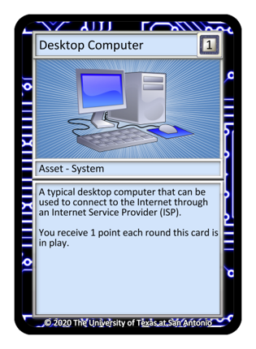
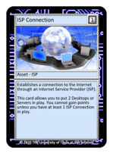
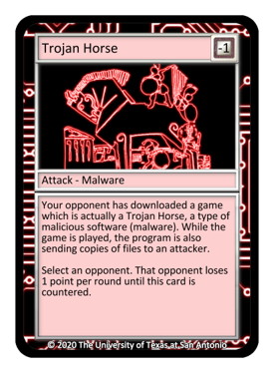
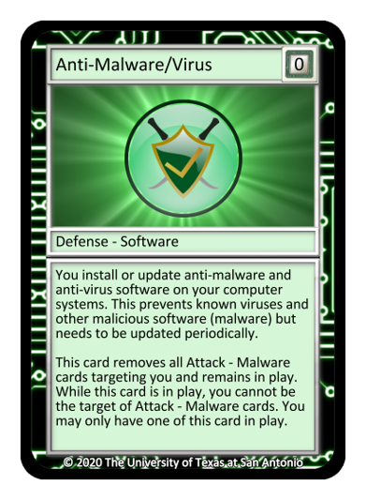
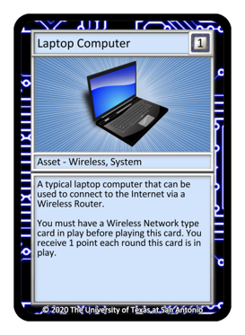
Can you identify what’s wrong?
2
Player Two has a malware type attack card in play while Player One has an Anti-Malware
Player One is using a laptop without the Wireless router card
1

Slide 26
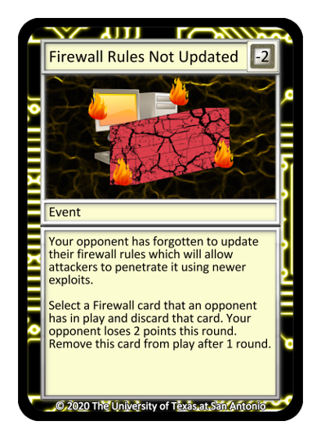
Identify What is Wrong
2
Player One has played a Firewall Rules Not Updated card but Player Two’s Host-Based Firewall has not been removed.
Player Two has three Desktop Computers in play but they only have one ISP Connection.
Reading the descriptions and names of these cards will help you avoid these mistakes
1

Slide 27
Thank you
For examples of a full round of play, download the Cyber Threat Defender rulebook or watch our video tutorials at CyberThreatDefender.com.

